Slide 1
WebView

Slide 2
WebView
If you want to deliver a web application (or just a web page) as a part of a client application, you can do it using WebView.
The WebView class is an extension of Android's View class that allows you to display web pages as a part of your activity layout.
It does not include any features of a fully developed web browser, such as navigation controls or an address bar.
All that WebView does, by default, is show a web page.

Slide 3

WebView
You should also get permission from user for using INTERNET in your app’s AndroidManifest.xml file.

Slide 4
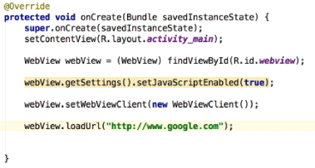
WebView – Showing any online webpage

Slide 5
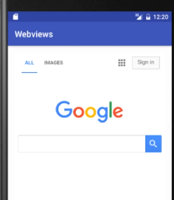
WebView – Showing any online webpage

Slide 6
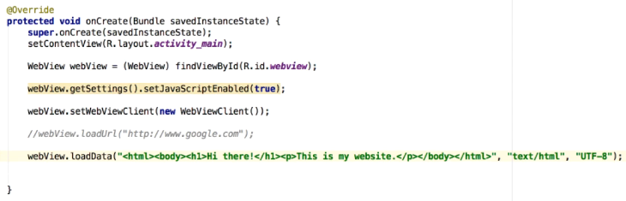
WebView – Displaying HTML Content

Slide 7
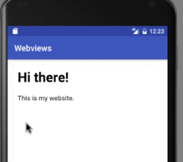
WebView – Displaying HTML Content

